Slide 1
Progress Report
20221522 권예준

Slide 2
Choose_word
def choose_word():
words = ["apple", "banana", "orange", "grape", "kiwi"]
return random.choice(words)

Slide 3
Display_word
def display_word(word, guessed_letters):
display = ""
for letter in word:
if letter in guessed_letters:
display += letter
else:
display += "_"
return display

Slide 4
Hangman (main function)
def hangman():
max_attempts = 6
guessed_letters = []
word_to_guess = choose_word()

Slide 5
Hangman (main function) 2
while True:
print("\nCurrent word: " + display_word(word_to_guess, guessed_letters)) print("Guessed letters: " + ", ".join(guessed_letters))
guess = input("Guess a letter: ").lower()
if guess in guessed_letters:
print("You've already guessed that letter. Try again.")
continue
guessed_letters.append(guess)

Slide 6
Hangman (main function) 3
if guess not in word_to_guess:
max_attempts -= 1
print("Incorrect guess. Attempts left: {}".format(max_attempts))
if max_attempts == 0:
print("Sorry, you ran out of attempts. The correct word was '{}'.".format(word_to_guess)) break
else: if set(guessed_letters) >= set(word_to_guess):
print("Congratulations! You guessed the word: '{}'".format(word_to_guess))
break

Slide 7

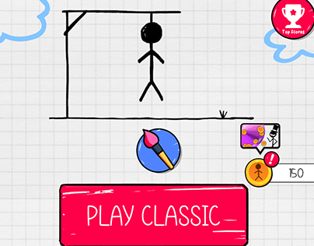
Design (not started yet)

